Slide 1
The Twitch API Project
Team 12: James Ballard, Justin Lee, Brandon Givens

Slide 2
Goals, Purposes of Project
Utilize the Twitch API to:
Build a webpage that does the following
1. Display top 10 current games on Twitch
2. Allow a user to search for a random stream based on certain parameters
Parameters: Game, language, minimum viewer count, maximum viewer count
Build a Chrome extension that implements the random game search functionality

Slide 3
Webpage Features
Pulls list of top 10 games on Twitch and displays their game image
Clicking on image also takes user to current viewed stream of that game
User can search for a random stream, add filters
User can connect their Twitch account to webpage
Not much functionality here currently, but it is an area to expand upon in the future
3-d dimensional stream view
Demo webpage!

Slide 4
Webpage Challenges, Bugs
3-D Twitch object sets all stream volumes to a default volume, rather than 3 on mute and one at a low volume
3-D Twitch object occasionally will have incorrect dimensions depending on brower/operating system user is one
Windows has issues in Chrome and Fedora has issues in Firefox
Random search algorithm has poor performance time
Game image display in inconsistent in formating

Slide 5
Webpage Future Features, Improvements
Ability to choose how many streams are in the 3d multistream object, and ability to create different 3d objects
CSS styling can always be improved
Improving the random stream search algorithm execution time
Adding some sort of stream search ability, such as being able to search for a specific streamer.

Slide 6
Extension Features
Implements same random stream search functionality as the webpage, but inside a Chrome extension rather than a browser
Demo!

Slide 7
Extension Challenges, Bugs
Utilizing Javascript within a Chrome extension
Jquery was troublesome to get working
Random search algorithm has a poor performance time
When opened, the extension popup dimensions are occasionally incorrect
Might be due to load order of files

Slide 8
Extension Future Features, Improvements
It would be nice to have some sort of Twitch account integration with the extension
Twitch account integration would allow for the following features:
1. Ability to display which streamers are currently online that the user follows, and possibly provide links
2. Blacklist certain games in random stream search, so that the search doesn’t give a stream of that game
3. Extension panel customization
Features 2. and 3. would both require some sort of backend for storing settings

Slide 9
An Important note
If we were to pursue this as a real product, we would need to make sure our styling does not attempt to emulate the styling of Twitch to avoid copyright issues. We would also need to change the tab icon from the Twitch mascot Glitch to one we owned the rights to. This note also applies to the extension.

Slide 10
Deployment Plan
Step 1: Secure domain and hosting services for webpage (2 months)
Choose domain name, determine hosting options, choose 1
Step 2: Host extension on Chrome (1 month)
Create developer count, pay fees, fill out necessary paperwork, publish extension
Step 3: Secure copyright (11 months)
Initiate copyright process, wait for process to complete

Slide 11
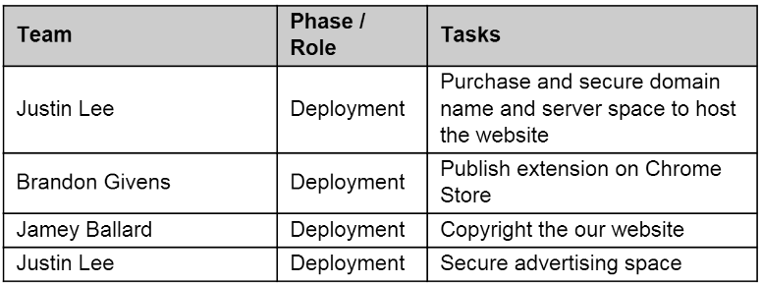
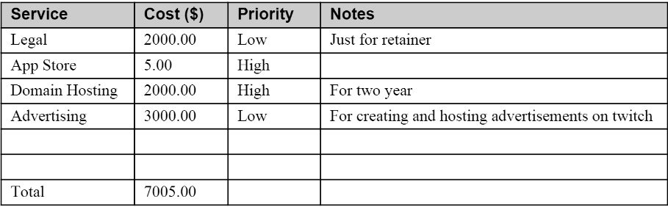

Slide 12
Maintenance Plan
This product cannot be legally sold because it makes use of the Twitch API.
So, to make any money, ads much be used or some sort of donation system put in place so that users can contribute if they feel like it.
As a result, this product isn’t something we could make a living off of, but could maintain as a sort of hobby project.

Slide 13
Maintenance Plan (cont)
The first order of business for maintenance would be finding some sort of web designer that would like to contribute to the project by making the webpage look better.
General maintenance would be fixing bugs as they arise, and keeping up with Twitch API updates.
For example, some of the API returns JSON code that utilizes an older format for encoding URLs, which leads to some issues when trying to parsing URLs.
The next priority would be adding more features.

Slide 14
Division of Labor
Webpage:
Jamey – Random search functionality, CSS, Twitch authentication, game list display, algorithm for populating game select list using PHP
Justin – 3-D Twitch object, Twitch authentication, CSS
Brandon – CSS
Extension
Brandon – Manifest, pop-up display, button functionality, algorithm for populating game select list using Javascript, CSS
Jamey – Random search algorithm

Slide 15
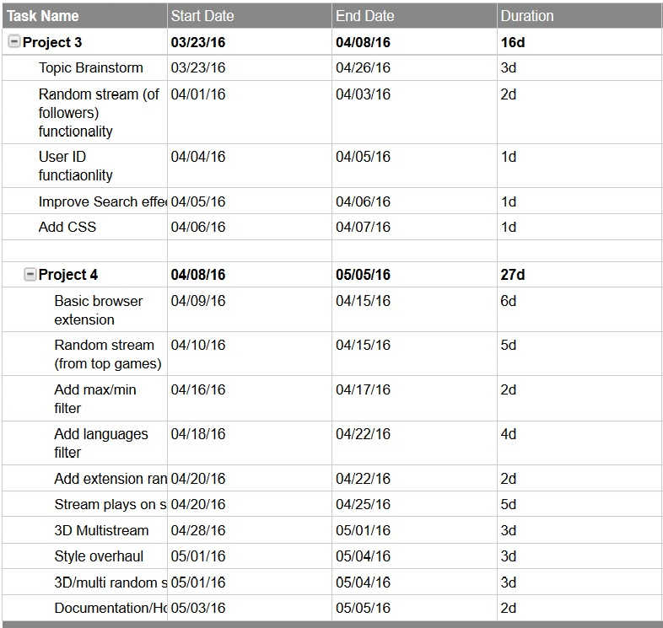
Gantt Chart

Slide 16
External Libraries Used
Webpage:
Twitch API, of course
Javascript 3d libraries (https://github.com/mrdoob/three.js/)
Extension:
Jquery was used in order to pull information from JSON strings from Twitch API
Also used the Twitch API

